Slide 1

DATA ANALYST PROJECT
Healthcare Data Analysis and Dashboard
~96K
7
patient records
Python charts
Patient, treatment and cost insights using Python, SQL and Power BI
30
1
SQL queries
Power BI dashboards
Presented by: Pranit Patil

Slide 2




INTRODUCTION
Project overview and workflow
Python
SQL
Power BI
Pandas, Matplotlib and Seaborn for cleaning, EDA and statistical charts: distributions, skew and outliers.
30 business questions on demographics, diagnosis, treatment, hospitals, billing and outcomes.
Interactive dashboards with KPIs, filters and drill-downs for hospital decision-makers.
Analysis workflow
1
Collect and clean data
2
Explore with Python
3
Query with SQL
4
Visualise in Power BI
5
Insights and actions
Goal: understand who the patients are, what they are treated for, what it costs and how outcomes vary across hospitals.

Slide 3

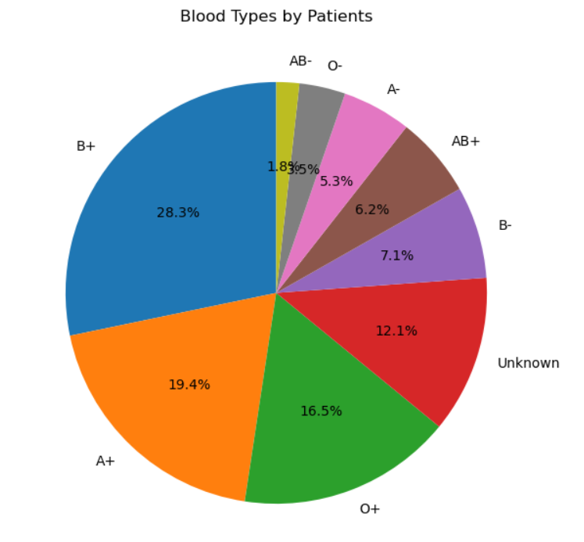
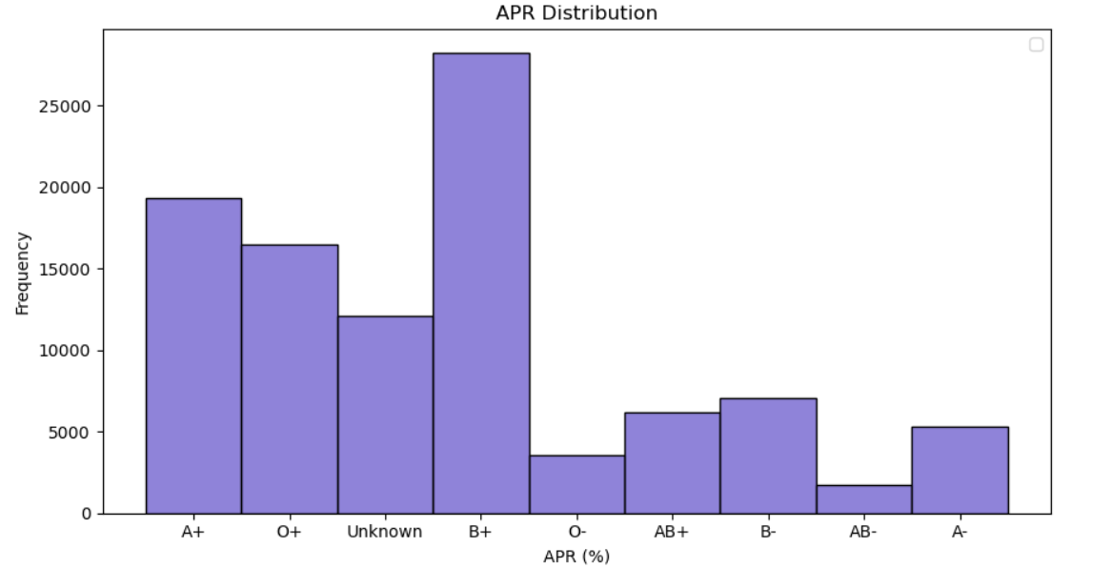
PYTHON | EDA
Blood group distribution
Pie chart: share of each blood type
A pie shows each category as a part of 100%, ideal for 8 to 9 groups.
B+ (28.3%), A+ (19.4%) and O+ (16.5%) cover about 64% of patients.
Count plot: absolute frequency
Bars compare raw counts more accurately than pie slices.
12.1% of blood types are Unknown, a data-quality gap to fix at intake.

Slide 4

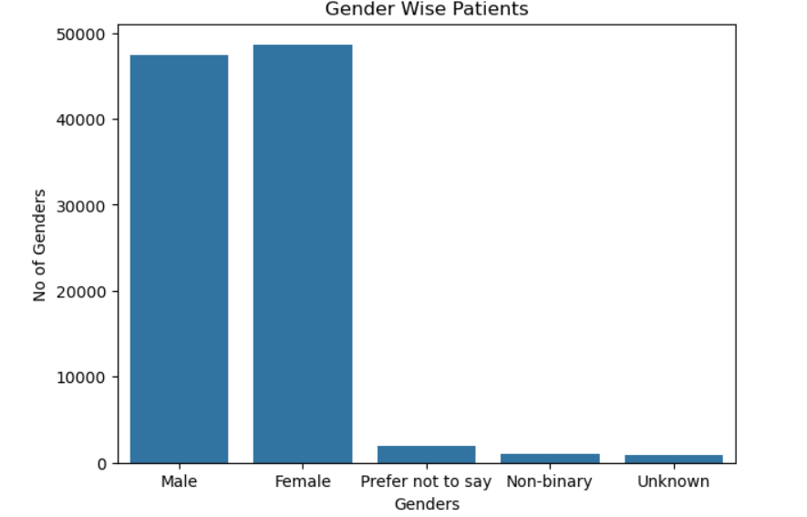
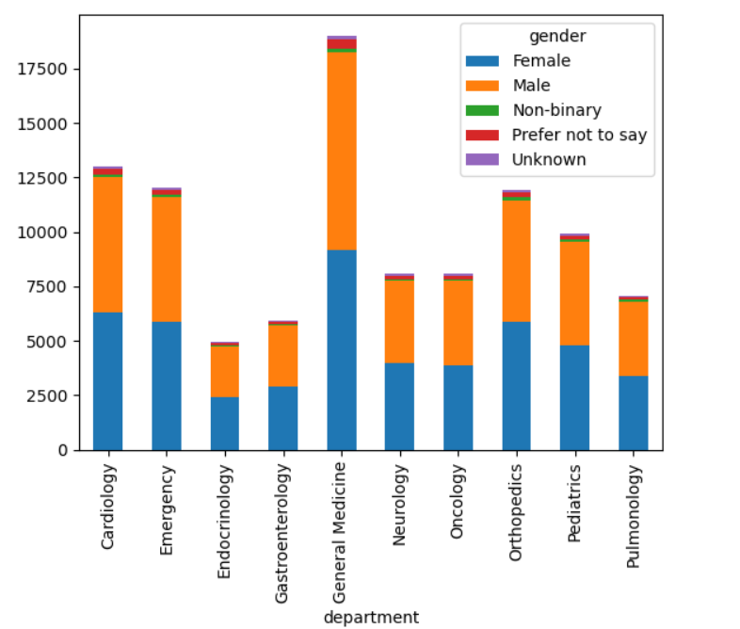
PYTHON | EDA
Gender and department load
Bar chart: patients by gender
Bar charts compare counts across categories.
Male and female patients are almost equal; other categories are under 3%.
Stacked bar: department by gender
Stacking shows total volume and gender mix together.
General Medicine is busiest (about 19K); Endocrinology is lowest (about 5K).

Slide 5

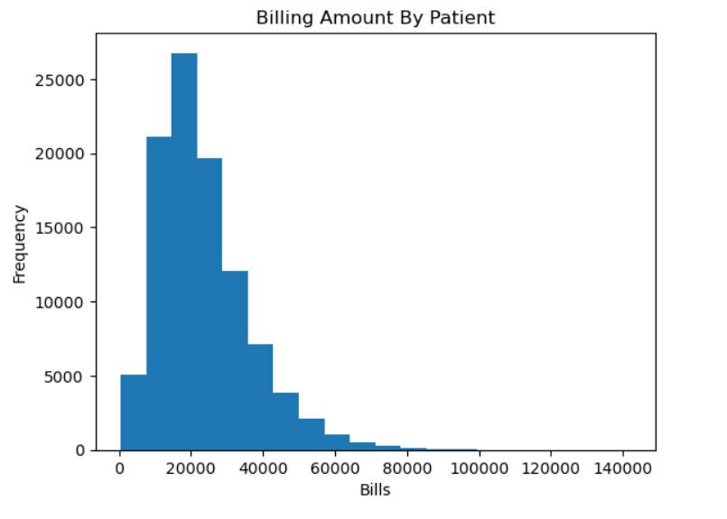
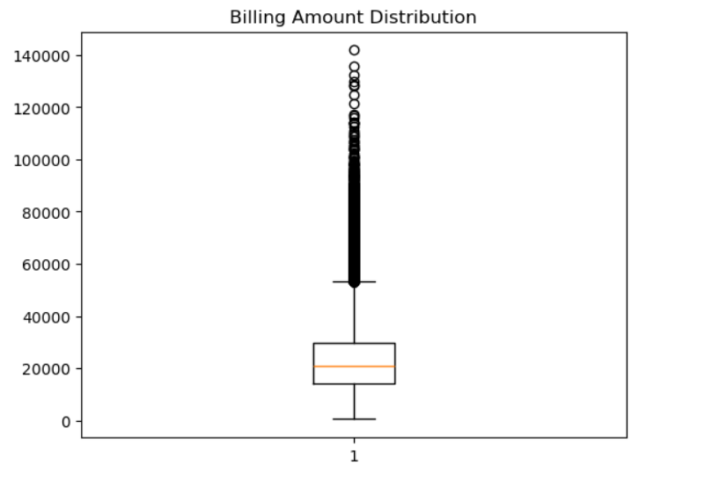
PYTHON | STATISTICS
Billing amount analysis
Histogram: shape of the bills
A histogram bins a numeric variable to reveal its distribution.
Right-skewed: most bills fall between 10K and 30K, with a long tail.
Box plot: median, spread, outliers
The box is the IQR (Q1 to Q3); the line is the median (about 21K).
Bills above roughly 53K are outliers, reaching about 140K, so use the median.

Slide 6

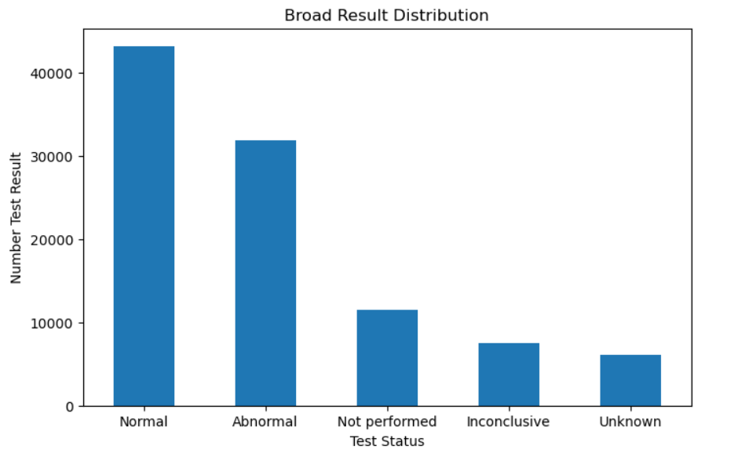
PYTHON | EDA
Test result distribution
Why it matters
A categorical bar chart shows how outcomes of medical tests are split.
Normal results lead (about 43K), followed by Abnormal (about 32K).
About 11K tests were Not performed and 6K are Unknown, worth auditing.
Abnormal rate is about a third of all results.
~43K
~32K
~11K
Normal
Abnormal
Not performed

Slide 7
SQL | QUESTIONS 1 TO 10
SQL: demographics and diagnosis
Patient Demographics
Disease and Diagnosis
1
Patients above 60 years
6
Patients per diagnosis
2
Count patients by gender
7
Top 5 most common diseases
3
Average age per disease
8
Mortality rate above 10%
4
Youngest cancer patient
9
Patients with multiple conditions
5
Patients grouped by city
10
Average stay per disease

Slide 8

SQL | QUESTIONS 11 TO 20
SQL: treatments and hospitals
Treatments
Hospital Analytics
11
Treatments for diabetes patients
16
Rank hospitals by patients treated
12
Average treatment cost per disease
17
Highest average treatment cost
13
Cost above overall average
18
Hospital-wise recovery rate
14
Rank treatments by frequency
19
Mortality rate above 5%
15
Patients with more than 3 treatments
20
Hospital with most cancer patients

Slide 9

SQL | QUESTIONS 21 TO 30
SQL: costs, billing and outcomes
Costs and Billing
Outcomes
21
Total revenue per hospital
26
Recovered vs deceased per disease
22
Patients with unpaid bills
27
Recovery rate by age group
23
Top 10 highest treatment costs
28
Longest average recovery time
24
Private vs government avg cost
29
Readmitted within 30 days
25
Monthly cost trend in 2026
30
Recovery rate: male vs female

Slide 10

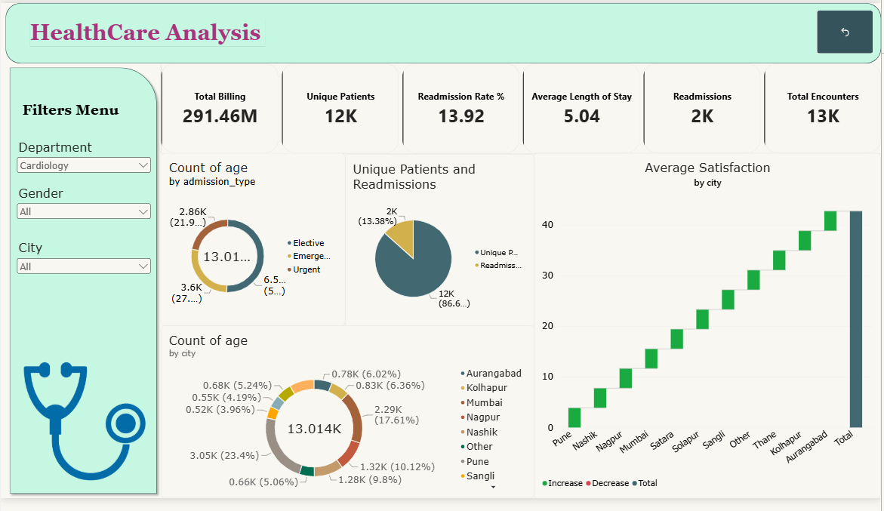
POWER BI
Dashboard 1: Healthcare Analysis
Healthcare Analytics – Key Points
Healthcare Analytics → Uses data to improve patient care and hospital efficiency.
KPIs → Billing, Patients, Readmission Rate, Length of Stay, Encounters.
Trends → Admission types (Elective, Emergency, Urgent), City-wise patient distribution.
Satisfaction → Shows service quality across cities, highlights improvement areas.
Benefits → Real-time monitoring, better decisions, improved outcomes, transparency.
12K
5.04 days
291.46M
Unique Patients
avg stay
Total Billing

Slide 11




Key findings and next steps
Demographics
Balanced gender mix; B+, A+ and O+ are the main blood groups.
Costs
Bills are right-skewed around 21K median with high-cost outliers.
Quality
About 12% blood types and 6K test results are Unknown; improve data capture.
Finance
Only 31% of claims are covered by payers, a risk for patient affordability.
Next steps: add predictive models for readmission and cost, and automate the Power BI refresh.
Thank you

